Slide 1

Hackathon Smart Contract
Ricardo Czernotzky, Lorenz Hajek, Waleri Janzen, Rabia Karatas, Joey Kiefer, Patrick Klyeisen, Alejandro Montemajor, Philipp Noack, Mustafa Satin, Jan Niclas Weiss
06.07.2018

Slide 2
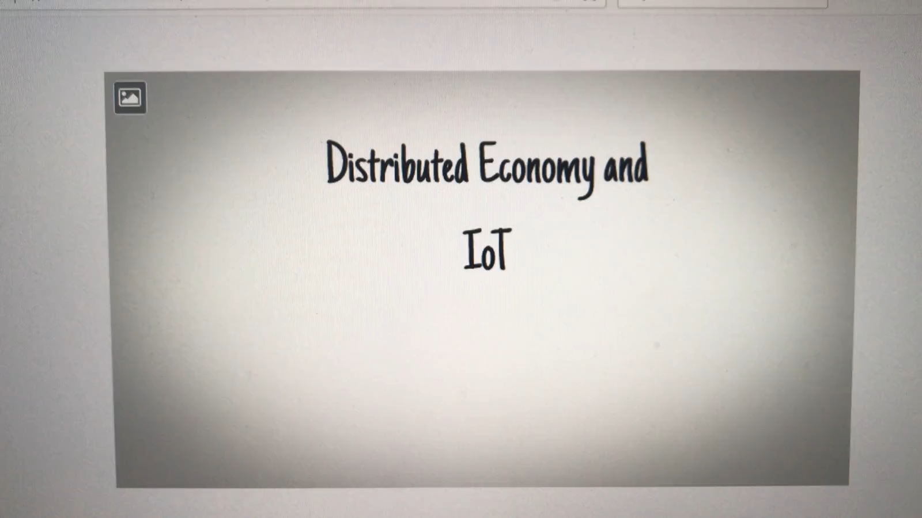
Video

Slide 3

Project Goal
Designing a business case and implementing a concept for using a smart contract within a private blockchain to represent the trade of electricity between multiple actors.
Notes:
Quelle: www.flaticon.com

Slide 4
Project Task
Establish a Business Case for the given Goal
Create a private blockchain network with 5 nodes by using Raspberry Pi’s and Notebooks
The 5 nodes represent electricity providers and consumers
Electricity prices and capacities are generated in a Matlab simulation
Based on this simulated data, a smart contract shall be established between the corresponding nodes
Notes:
Quelle: www.flaticon.com

Slide 5
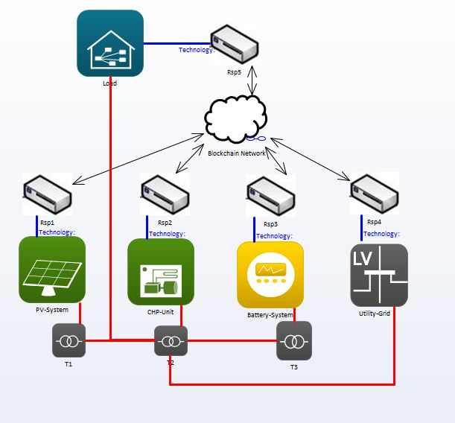

Component Layer
5 nodes connected via the Blockchain
nodes connected to the power grid
corresponds to the Matlab model which generates the data
Notes:
Quelle: www.flaticon.com

Slide 6
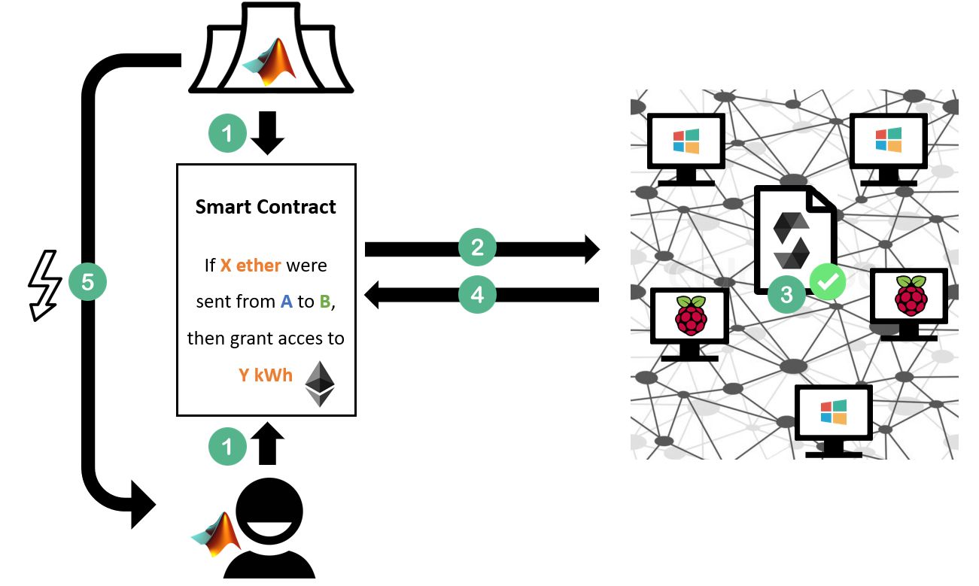
Concept:
Matlab Simulation provides data
The Smart Contract data is written to the blockchain
The Smart Contract is verified by all nodes in the Blockchain network
When the network verifies the Smart Contract, the Contract is executed
The customer receives the electricity agreed in the contract

Slide 7







-30
Grid
CHP
30 ether
Smart Contract
Battery
Grid:
Battery:
PV:
Load:
CHP:
Total:
+30
Balance:
+10
+10
+40
40 ether
10 ether
Load
+40
-10
PV

Slide 8
Live Demo

Slide 9
Thank You!

